Slide 1
DIGITAL LOGIC GATES

Slide 2
Content
Digital Logic Gates
Logic Gates
Realization of logic expressions using basic and Universal gates.
Verification and interpretation of truth table for AND, OR, NOT, NAND, NOR, Ex-OR,
Ex-NOR gates.
Boolean Algebra
Realization of logic functions with the help of universal gates (NAND and NOR).

Slide 3

Logic Gates
Logic gates are the building blocks used to create digital circuits.
It is an electronic circuit that operate on one or more input signals to produce an output
signal.
Imagine you have a battery connected to two switches, A and B, in series with a light bulb. The two switches make up a logic gate. Because they are in series, switch A AND switch B both have to be switched on (i.e. logic 1) to make a complete circuit so that the bulb will light (logic 1 also).
But looking at the circuit another way, what would be required to make the bulb not light (i.e. logic 0). Well provided switch A OR switch B are switched off (logic 0), then the bulb will not be lit. So these switches can provide an OR or an AND function, depending on how you look at the circuit.
Actually the term logic is applied to digital circuits used to implement logic functions. Several kinds of digital logic circuits are the basic elements that form the building blocks for such complex digital system as the computer.
The lines connected to each symbols are the inputs and outputs.
The inputs are on the left of each symbol and the output is on the right.
A circuit that performs a specific logic operation (AND, OR) is called a logic gate.

Slide 4
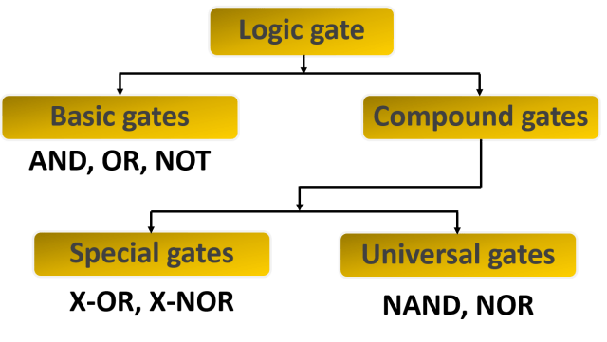
Contd…

Slide 5
Contd…
There are three different, but equally powerful, notational methods for describing the
behaviour of gates and circuits
Boolean expressions
Logic diagrams
Truth tables
Boolean Algebra: expressions in this algebraic notation are an elegant and powerful way to demonstrate the activity of electrical circuits which gives visual representation of the switching function of the system.
Logic Diagram: a graphical representation of a circuit
Each type of gate is represented by a specific graphical symbol
Truth Table: defines the function of a gate by listing all possible input combinations that the gate could encounter, and the corresponding output

Slide 6


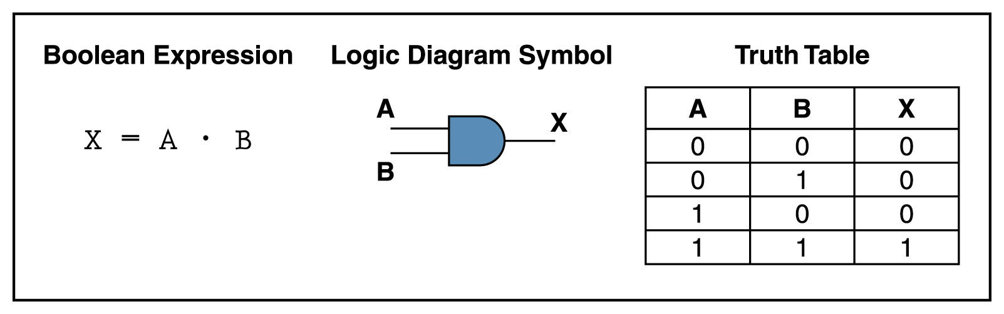
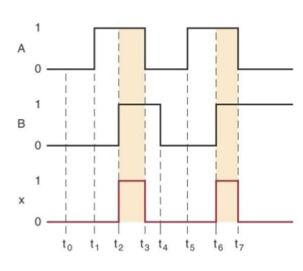
AND Gate
An AND gate can have two or more inputs and performs what is know as multiplication.
The output of AND gate is high when all inputs are high otherwise all outputs are low.
Timing Diagram
RTL

Slide 7
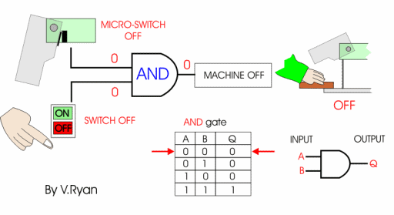
AND Gate

Slide 8

Summary of the AND Operation
The AND operation is performed the same as ordinary multiplication of 1s and 0s.
An AND gate is a logic circuit that performs the AND operation on the circuit’s inputs.
An AND gate output will be 1 only for the case when all inputs are 1; for all other cases the output
will be 0.
The expression x=A.B is read as “x equals A AND B.”
Review Questions:
What is the only input combination that will produce a HIGH at the output of a five-input AND gate?
2. What logic level should be applied to the second input of a two-input AND gate if the logic signal at
the first input is to be inhibited(prevented) from reaching the output?
3. True or false: An AND gate output will always differ
conditions.
from an OR gate output for the same input

Slide 9
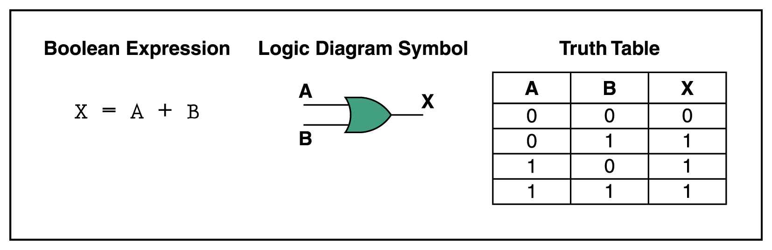
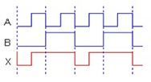
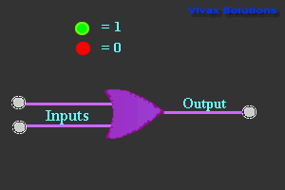
OR Gate
OR gate can have two or more inputs and performs what is known as logical addition.
The output of OR gate is Low when all inputs are low, else all outputs are high.
Timing Diagram
RTL

Slide 10
Summary of OR Operation
Produce a result of 1 whenever any input is 1. Otherwise 0.
An OR gate is a logic circuit that performs an OR operation on the circuit's input
The expression x=A+B is read as “x equals A OR B”
Review Questions:
What is the only set of input conditions that will produce a LOW output for any OR gate?
Write the Boolean expression for a six-input OR gate
If the A input in previous example is permanently kept at waveform be?
the 1 level, what will the resultant output

Slide 11
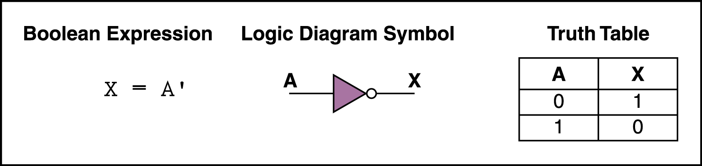
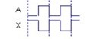
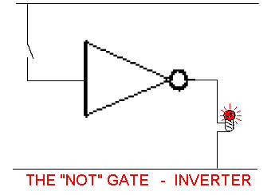
Not Gate (Inverter)
The inverter (NOT circuit) performs the operation called inversion or complementation.
The NOT operation changes one logic level to the opposite logical level. When the input is Low, the output is high. When the input is high, the output is low.
Timing Diagram

Slide 12
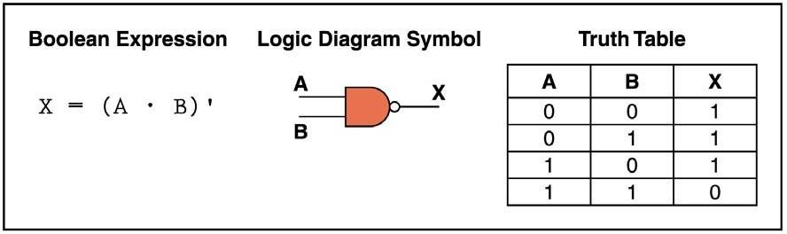
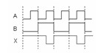
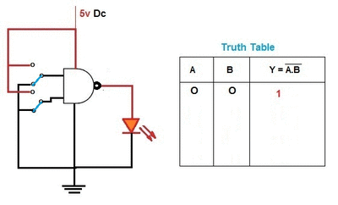
NAND Gate
NAND gate is of the popular logic circuit because it can be used as a universal gate; that is NAND gate can be used in combination to perform the AND, OR, and inverter operations.
It is constructed by attaching NOT Gate at the output of AND Gate, hence NAND Gate is called NOT- AND Gate.
The output of NAND gate is low when all inputs are high, else all outputs are high.
Timing Diagram

Slide 13
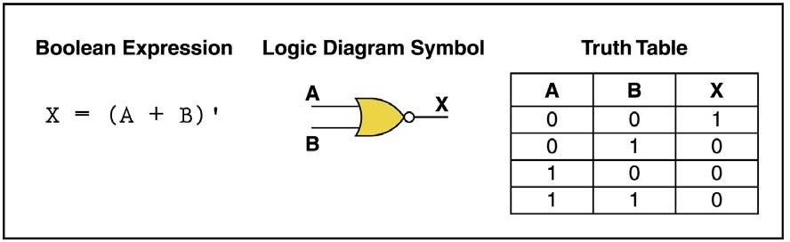
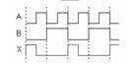
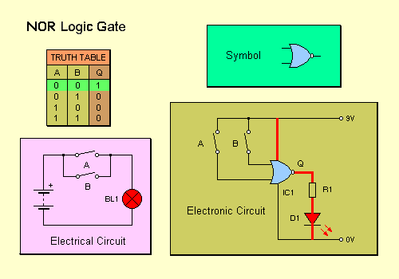
NOR Gate
NOR gate is also useful logical element because it can also be used as a universal gate.
It can be used in combination to perform the AND, OR and Inverter operations.
NOR Gate is the combination of NOT gate at the output of OR gate, hence NOR gate is type of NOT-OR gate.
The Output of NOR gate is high when all inputs are low otherwise the output is low.
Timing Diagram

Slide 14
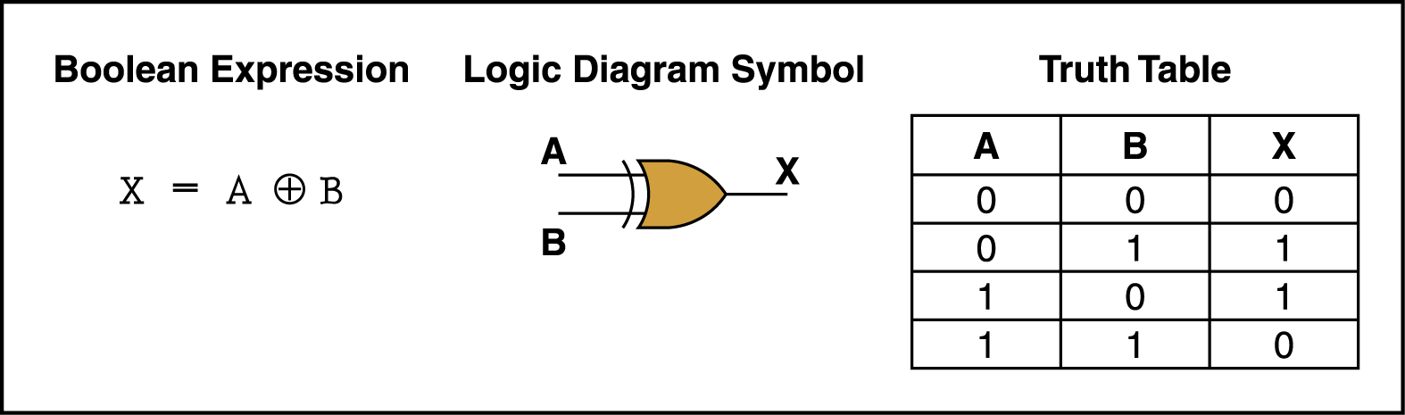
Exclusive- OR Gate
Exclusive-OR gate is a logical operation that outputs true only when inputs differ (one is true, the other is false).
The exclusive-OR gate has a graphical symbol similar to that of the OR gate, except for the additional curved line on the input side.
If both inputs are Low or both are High then it produces the output Low or 0. otherwise it produce the High.

Slide 15
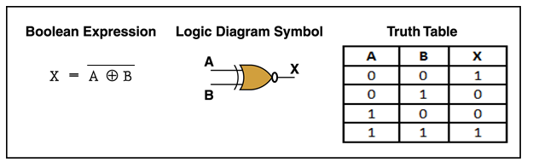
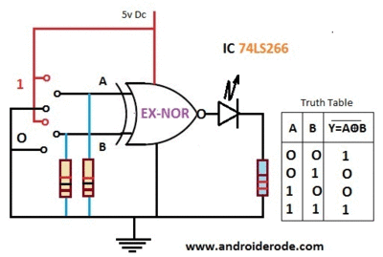
Exclusive-NOR Gate
The exclusive-NOR gate is the complement of the exclusive-OR gate, as indicated by small circle on the output side of the graphic symbol.
If both inputs are Low or both are High then it produces the output High or 1.
otherwise it produce the Low output.

Slide 16
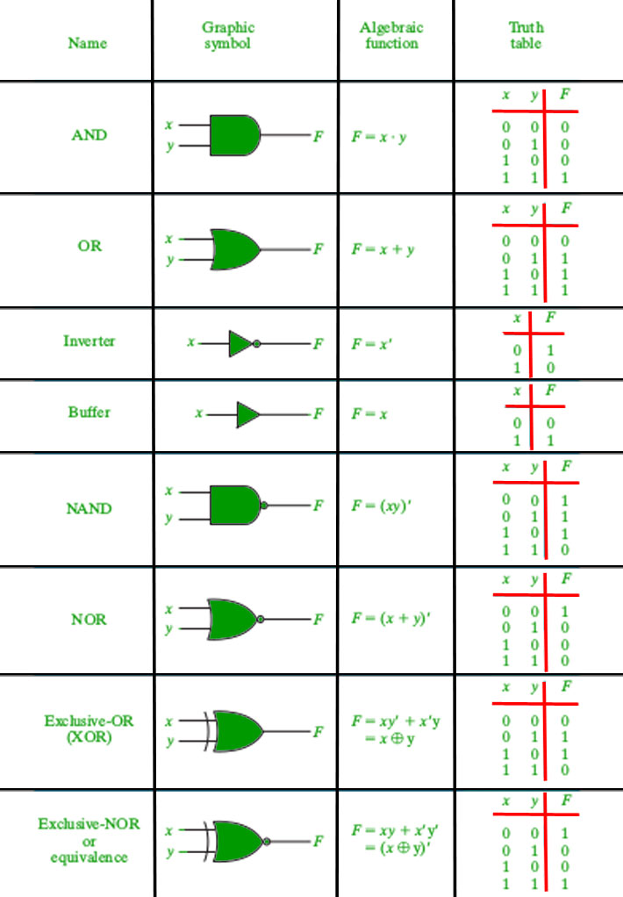

Slide 17
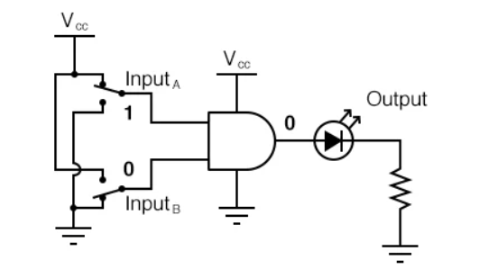
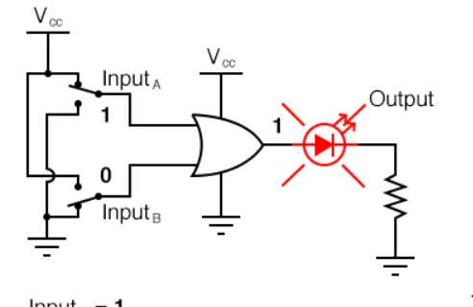
Time to Quiz?
1
2

Slide 18
Boolean Algebra
Boolean algebra can be considered as an algebra that deals with binary variables and logic operations.
Boolean algebraic variables are designated by letters such as A, B, x, and y.
The basic operations performed are AND, OR, and complement.
The Boolean algebraic functions are mostly expressed with binary variables, logic operation symbols, parentheses, and equal sign.

Slide 19
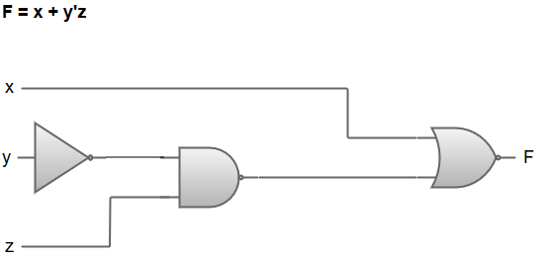
Boolean Algebra
For a given value of variables, the Boolean function can be either 1 or 0. For instance, consider the Boolean function:
F = x + y’z
The logic diagram for the Boolean function F = x + y'z can be represented as:
F = x + y'z
The Boolean function F = x + y'z is transformed from an algebraic expression into a logic diagram composed of AND, OR, and inverter gates.
Inverter at input 'y' generates its complement y'.
There is an AND gate for the term y'z, and an OR gate is used to combine the two terms (x and y'z).
The variables of the function are taken to be the inputs of the circuit, and the variable symbol of the function is taken as the output of the circuit.

Slide 20
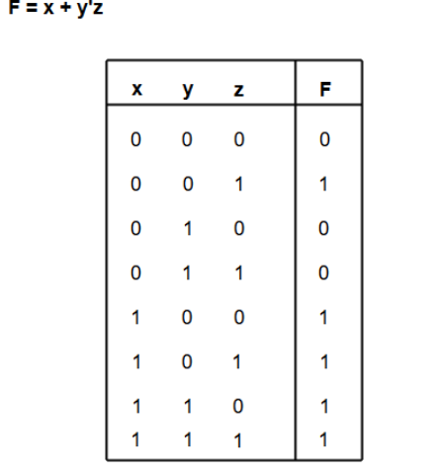
The truth table for the Boolean function F = x + y'z can be represented as:

Slide 21
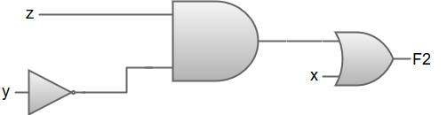
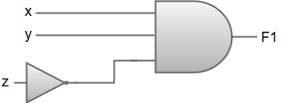
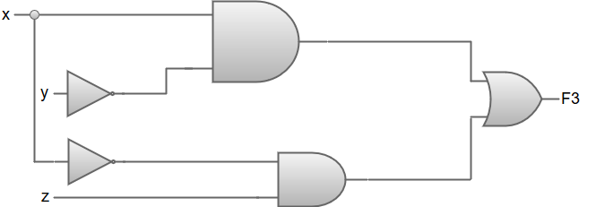
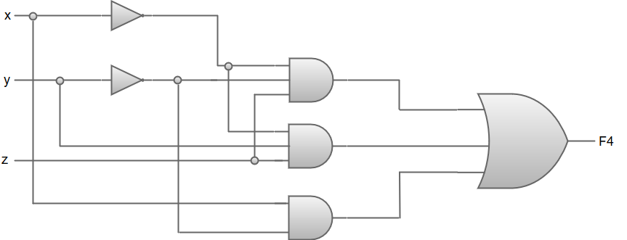
Examples of Boolean algebra simplifications using logic gates
1. F1 = xyz'
2. F2 = x + y'z
3. F3 = xy' + x'z
4. F4 = x'y'z + x'yz + xy'

Slide 22
Laws of Boolean algebra
The basic Laws of Boolean Algebra can be stated as follows:
Commutative Law states that the interchanging of the order of operands in a Boolean equation does not change its result. For example:
OR operator → A + B = B + A
AND operator → A * B = B * A
Associative Law of multiplication states that the AND operation are done on two or more than two variables. For example:
A * (B * C) = (A * B) * C

Slide 23
Laws of Boolean algebra
Distributive Law states that the multiplication of two variables and adding the result with a variable will result in the same value as multiplication of addition of the variable with individual variables.
For example: A + BC = (A + B) (A + C).
Annulment law: A.0 = 0 A + 1 = 1
Identity law: A.1 = A A + 0 = A
Idempotent law: A + A = A A.A = A
Complement law: A + A' = 1 A.A'= 0
Double negation law: ((A)')' = A
Absorption law: A.(A+B) = A A + AB = A

Slide 24
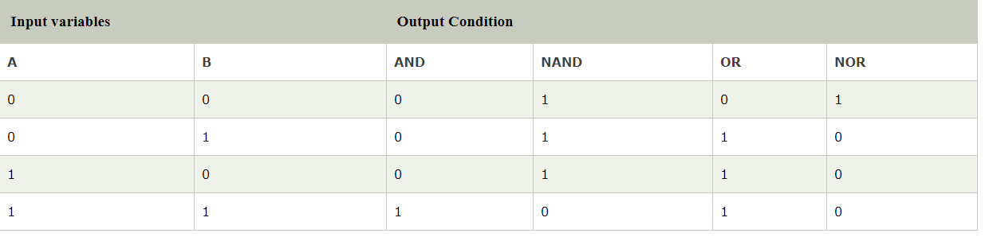
De-Morgan's Theorem
A famous mathematician DeMorgan invented the two most important theorems of boolean algebra.
The DeMorgan's theorems are used for mathematical verification of the equivalency of the NOR and negative-AND gates and the negative-OR and NAND gates.
These theorems play an important role in solving various Boolean Algebra expressions. In the below table, the logical operation for each combination of the input variable is defined.

Slide 25
Rules of De-Morgan’s Theorem
The rules of De-Morgan's theorem are produced from the Boolean expressions for OR, AND, and NOT using two input variables x and y.
The first theorem of Demorgan's says that if we perform the AND operation of two input variables and then perform the NOT operation of the result, the result will be the same as the OR operation of the complement of that variable.
The second theorem of DeMorgan says that if we perform the OR operation of two input variables and then perform the NOT operation of the result, the result will be the same as the AND operation of the complement of that variable.

Slide 26
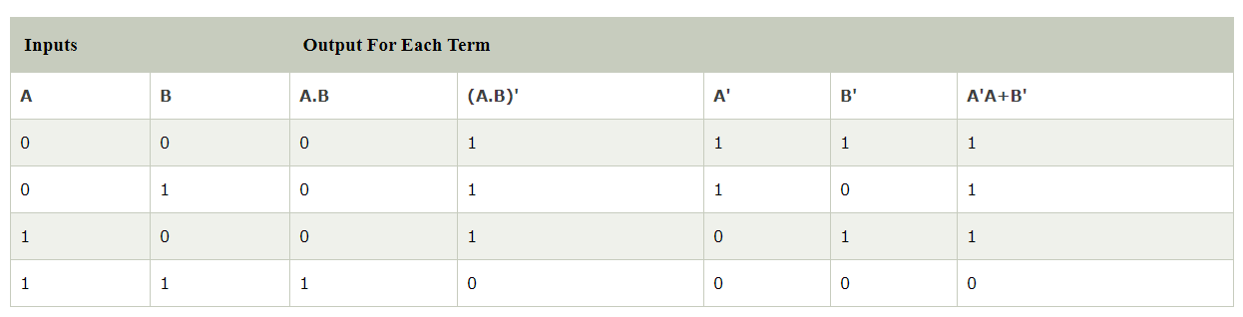
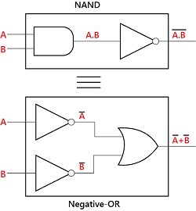
De-Morgan's First Theorem
According to the first theorem, the complement result of the AND operation is equal to the OR operation of the complement of that variable.
Thus, it is equivalent to the NAND function and is a negative-OR function proving that (A.B)' = A'+B' and we can show this using the following table.

Slide 27
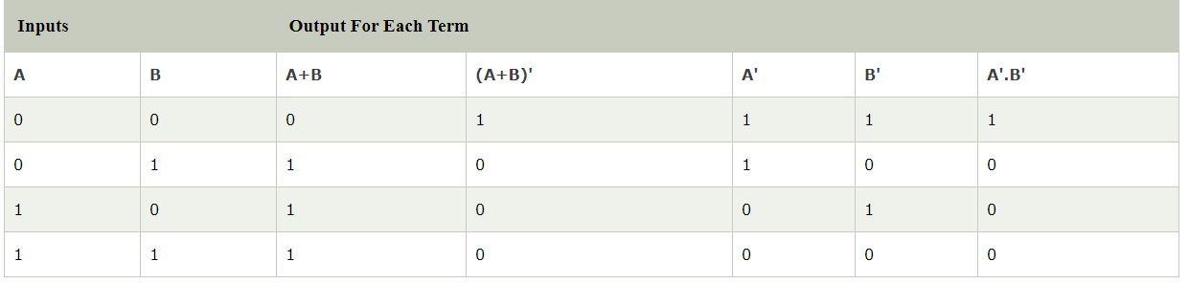
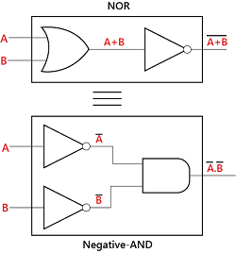
De-Morgan's Second Theorem
According to the second theorem, the complement result of the OR operation is equal to the AND operation of the complement of that variable.
Thus, it is the equivalent of the NOR function and is a negative-AND function proving that (A+B)' = A'.B' and we can show this using the following truth table.

Slide 28
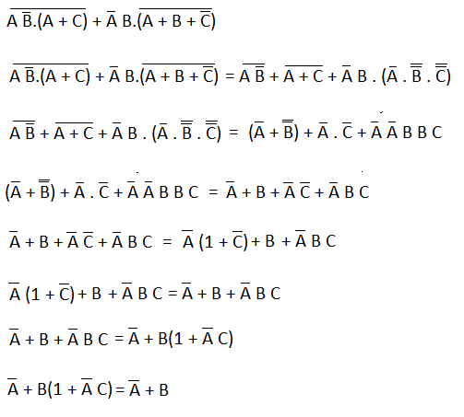
Examples
Example 1: (A.B.C)'
(A.B.C)'=A'+B'+C’
Example 2: (A+B+C)'
(A+B+C)'=A'.B’.C
Example 3: (AB'.(A + C))'+ A'B.(A + B + C')'

Slide 29
NAND Gate as Universal Gate

Slide 30


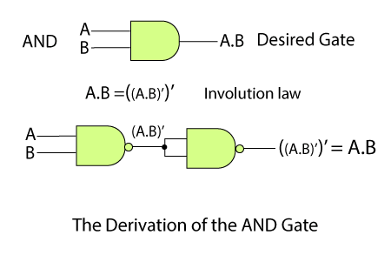
AND gate using NAND gate
Truth Table
Inputs |  | Output
X | Y | Z
0 | 0 | 0
0 | 1 | 0
1 | 0 | 0
1 | 1 | 1

Slide 31
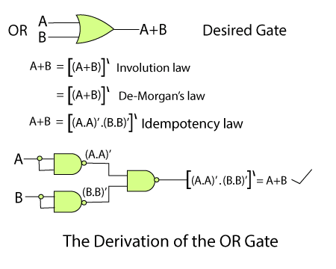
NAND Gate as an OR Gate
Truth Table
Inputs |  | Output
X | Y | Z
0 | 0 | 0
0 | 1 | 1
1 | 0 | 1
1 | 1 | 1

Slide 32

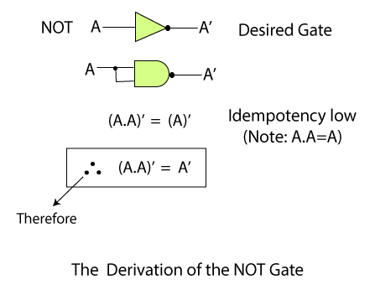
NAND Gate as a NOT Gate
Truth Table
Input | Output
X | Z
0 | 1
1 | 0

Slide 33
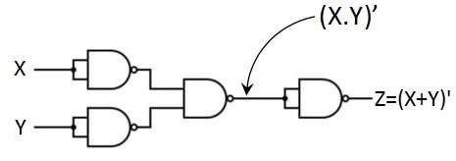
NAND Gate as a NOR Gate
Truth Table
Inputs |  | Output
X | Y | Z
0 | 0 | 1
0 | 1 | 0
1 | 0 | 0
1 | 1 | 0

Slide 34
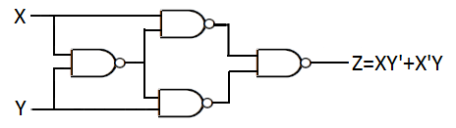
NAND Gate as an Ex-OR Gate
Truth Table
Inputs |  | Output
X | Y | Z
0 | 0 | 0
0 | 1 | 1
1 | 0 | 1
1 | 1 | 0

Slide 35
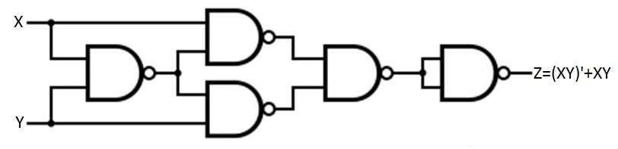
NAND Gate as an Ex-NOR Gate
Truth Table
Inputs |  | Output
X | Y | Z
0 | 0 | 1
0 | 1 | 0
1 | 0 | 0
1 | 1 | 1

Slide 36
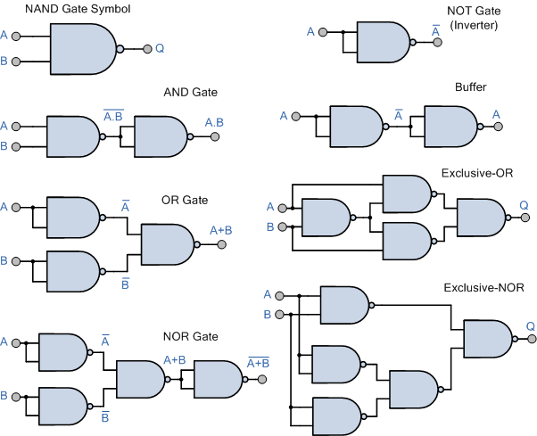
NAND Gate as Universal Gate

Slide 37
NOR Gate as Universal Gate

Slide 38
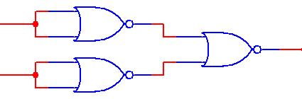
NOR Gate as an AND Gate
X
X
Y
Z = X + Y = X Y = X Y
Y
“Inverters”
NOR Gate
Truth Table
Inputs |  | Output
X | Y | Z
0 | 0 | 0
0 | 1 | 0
1 | 0 | 0
1 | 1 | 1

Slide 39
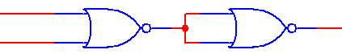
NOR Gate as an OR Gate
X +Y
X
Y
Z = X + Y = X +Y
NOR Gate
“Inverter”
Truth Table
Inputs |  | Output
X | Y | Z
0 | 0 | 0
0 | 1 | 1
1 | 0 | 1
1 | 1 | 1

Slide 40
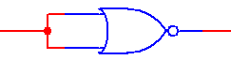
NOR Gate as a NOT Gate
_{X+ X = X}(Before Bubble)
X
Z =X
Truth Table
Inputs | Output
X | Z
0 | 1
1 | 0

Slide 41
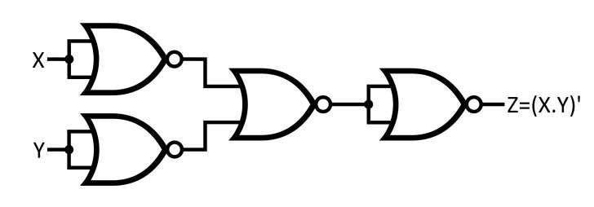
NOR Gate as a NAND Gate
Truth Table
Inputs |  | Output
X | Y | Z
0 | 0 | 1
0 | 1 | 1
1 | 0 | 1
1 | 1 | 0

Slide 42

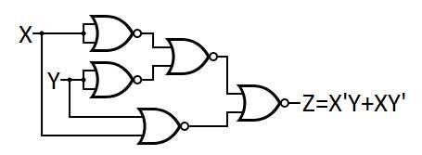
NOR Gate as an Ex-OR Gate
Truth Table
Inputs |  | Output
X | Y | Z
0 | 0 | 0
0 | 1 | 1
1 | 0 | 1
1 | 1 | 0

Slide 43
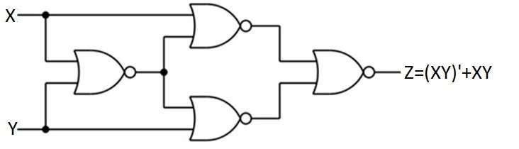
NOR Gate as an Ex-NOR Gate
Truth Table
Inputs |  | Output
X | Y | Z
0 | 0 | 1
0 | 1 | 0
1 | 0 | 0
1 | 1 | 1

Slide 44
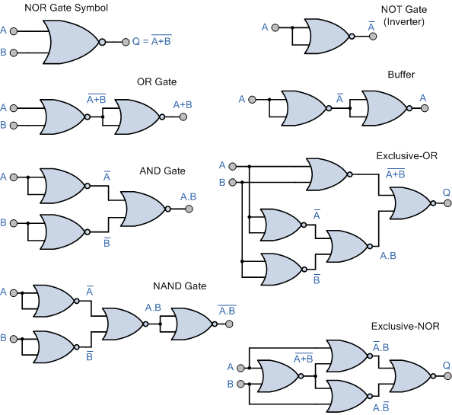
NOR GATE AS UNIVERSAL GATE

Slide 45

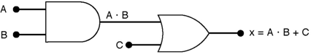
Describing Logic Circuits Algebraically
Any logic circuit, no matter how complex, can be completely described using the three basic Boolean operations: OR, AND, NOT.
Example: Logic circuit with its Boolean expression

Slide 46
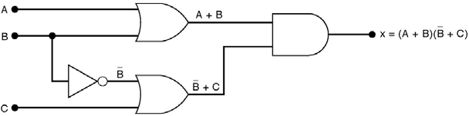
Activity
Draw the circuit diagram to implement the expression
x = ( A + B )( B + C )

Slide 47

Determining Output Value from a Logic Circuit

Slide 48

Applications of Logic Gates
NAND Gates are used in Burglar alarms and buzzers.
They are basically used in circuits involving computation and processing.
They are also used in push button switches. E.g. Door Bell.
They are used in the functioning of street lights.
AND Gates are used to enable/inhibit the data transfer function.

Slide 49
Useful Links
http://www.powershow.com/view/1f9351OGY1M/Logic_Gates_powerpoint_ppt_presentation
https://de-iitr.vlabs.ac.in/exp/truth-table-gates/
https://de-iitr.vlabs.ac.in/exp/realization-of-logic-functions/

Slide 50


Slide 51

AND Gate

Slide 52

OR Gate

